Slide 1

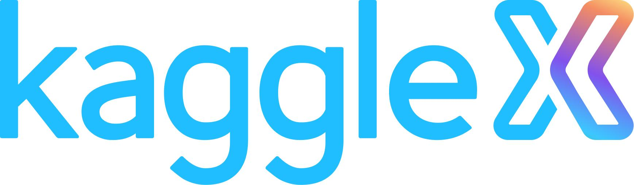

Open Source LLm based chatbot with Private/sensitive medical data
I am a medical student (veterinary) and an AI engineer
Notes:
Recommending picking out he most interesting and important parts from your documentation.

Slide 2
A medical chatbot for private sensitive data
Nagarajan Shunmugam

Slide 3
Background – My life in India
Undergraduate degree – specialized in embedded systems
Worked in IIT Madras – Bio medical company / research lab embedded engineer
Worked in IIT Delhi – Self driving cars
Mentor and alpha tester at Coursera

Slide 4



My life in Europe
Dual masters in AI & Robotics
TU Berlin
KTH Royal
Scania, several startups
Founded my first company in the veterinary medicine and AI

Slide 5

Currently, Studying veterinary medicine 3rd year in Wroclaw, Poland

Slide 6
Large language models

Slide 7
New Age of LLMs
Larger and More Powerful Models:
LLMs are becoming larger and more powerful, enabling them to handle complex language tasks.
Multimodal Capabilities:
They now have the ability to process and generate text, images, audio, and video data.
Continual Advancements:
Ongoing research and development lead to improvements in natural language understanding and generation.
Notes:
https://lab.mlaw.gov.sg/files/Sample-filled-in-MR.pdf
Data sample report

Slide 8
Benefits of New LLMs
Enhanced Language Understanding:
LLMs provide more accurate and nuanced language understanding, reducing errors.
Efficient Content Generation:
They help in generating high-quality, contextually relevant content quickly.
Improved Multimodal Insights:
LLMs can analyze and interpret a wide range of data types, offering more comprehensive insights.
Notes:
https://lab.mlaw.gov.sg/files/Sample-filled-in-MR.pdf
Data sample report

Slide 9
Potential Use Cases in Medicine
The new age of LLMs presents opportunities to revolutionize healthcare by providing more accurate, efficient, and personalized services.
Medical Record Analysis:
LLMs can extract insights from medical records, assisting in diagnosis and treatment planning.
Clinical Decision Support:
They can provide real-time guidance to healthcare professionals, improving treatment decisions.
Patient Communication:
LLMs enable personalized, empathetic patient communication through chatbots and virtual assistants.
Notes:
https://lab.mlaw.gov.sg/files/Sample-filled-in-MR.pdf
Data sample report

Slide 10
Potential Use Cases in Medicine
Drug Discovery and Research:
LLMs aid in analyzing vast amounts of medical literature, accelerating drug discovery.
Telemedicine:
They enhance remote consultations by facilitating automated medical history analysis.
Healthcare Chatbots:
LLM-powered chatbots offer accurate information and symptom assessment, improving patient experience.
Notes:
https://lab.mlaw.gov.sg/files/Sample-filled-in-MR.pdf
Data sample report

Slide 11
Medical Record Analysis: LLMs can extract insights from medical records, assisting in diagnosis and treatment planning.

Slide 12
The open source models

Slide 13
New Open Source Models: LLMs like Llama 2
LLMs like Llama 2 are part of the new generation of open-source language models. They promise significant advancements in language understanding, text generation, and their applications across various domains. These models are built on extensive datasets and open-source principles, making them accessible and versatile.
Promise for the Future
Improved Natural Language Understanding: LLMs like Llama 2 offer enhanced comprehension of human language, making them valuable for a wide range of applications, from content generation to conversational AI.
Multimodal Capabilities: They can handle not only text but also images, audio, and video data, enabling more comprehensive and context-aware insights and responses.
Innovation and Democratization: Open-source models like Llama 2 foster innovation and democratization in the AI space by allowing developers worldwide to access and build upon the technology.
Customization for Diverse Industries: These models can be fine-tuned and customized for specific industries, addressing unique challenges and requirements, such as healthcare, finance, and e-commerce.

Slide 14
Privacy Protection
Data Privacy Safeguards: Open-source projects often emphasize data privacy and offer guidelines for responsible use, ensuring that personal data isn't misused.
Ethical Guidelines: Ethical considerations, such as fairness, transparency, and bias mitigation, are integrated into the development and use of these models.
Privacy-Preserving AI: Techniques like federated learning and differential privacy are applied to protect individuals' data while improving the model's performance.
User Control: Users are given control over their data and can choose how their information is utilized, promoting transparency and trust.
Regulatory Compliance: Open-source projects often align with data protection regulations, ensuring legal compliance in various regions.
Open-source models like Llama 2 represent the cutting edge of AI, offering powerful language understanding capabilities while prioritizing privacy and ethical considerations. Their collaborative, transparent, and customizable nature makes them a promising force for the future of AI applications.

Slide 15
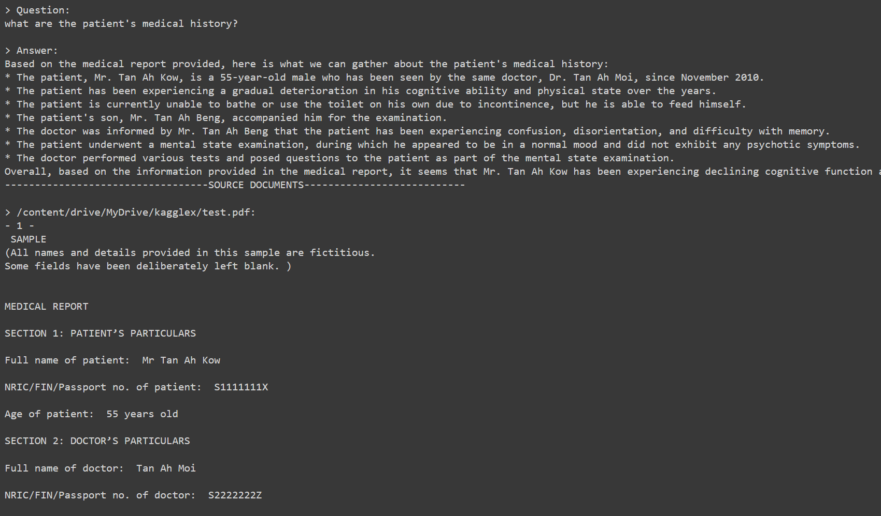

Slide 16
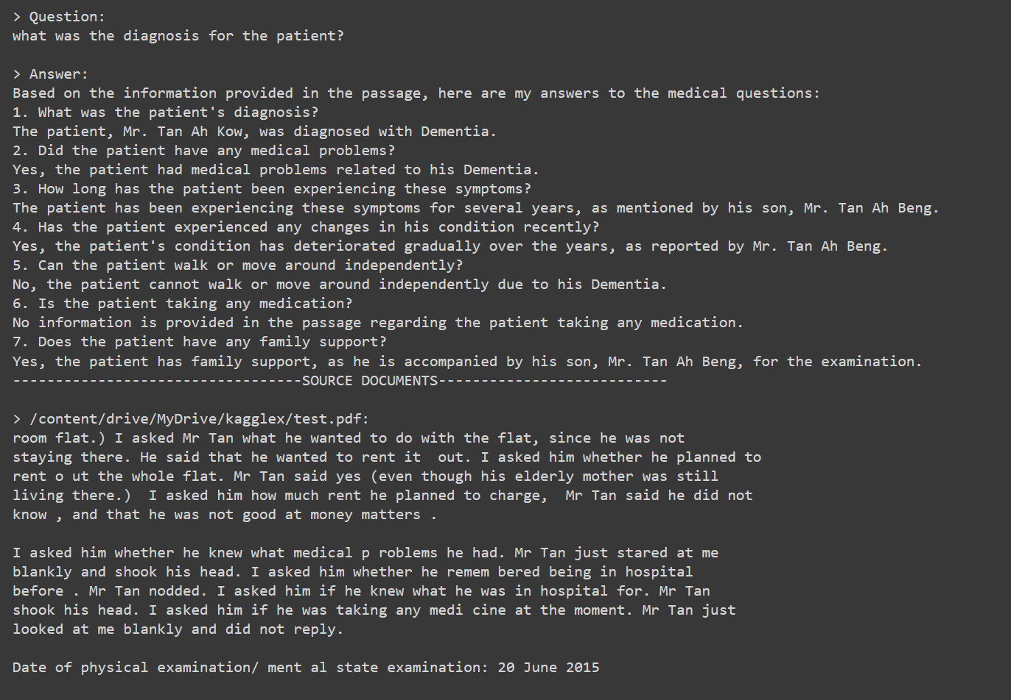

Slide 17
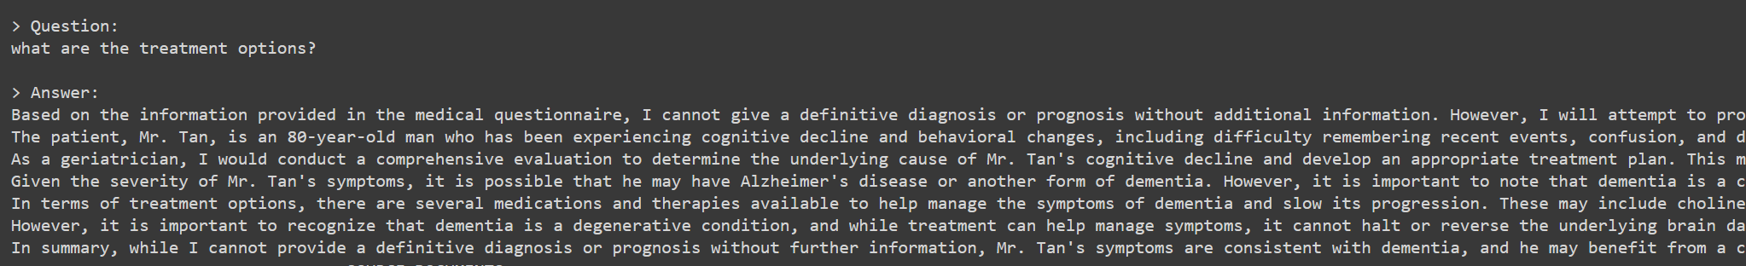

Slide 18
Project Links
https://github.com/TinyAnts/Kaggle-X-Bipoc-program-Medical-chatbot
https://lab.mlaw.gov.sg/files/Sample-filled-in-MR.pdf

